Slide 1
Memory Management Virtual Memory Management
Lecture 9 (Live Version)

Slide 2
Overview
Virtual Memory:
Motivation
Basic Idea
Page Fault
Common application of Virtual Memory:
Demand Paging
Aspects of virtual memory management:
Page Table Structure
Page Replacement Algorithms
Frame Allocation

Slide 3
Virtual Memory: Motivation
Our assumptions:
Too restrictive:
What if the logical memory space of process is >> than physical memory?
What if the same program is executed on a computer with lesser physical memory?
1. Each process occupies a contiguous memory region
2. The physical memory is large enough to contain one or more processes with complete memory space

Slide 4
Virtual Memory: Basic Idea
Secondary Storage Capacity
>> Physical Memory Capacity
Basic Idea:
Split the logical address space into small chunks:
Some chunks reside in physical memory
Other are stored on secondary storage
The most popular approach:
Extension of the paging scheme

Slide 5
Virtual Memory: Paging Illustration
Page 4
Page 0
Page 5
Page 1
Page 2
Page 3
Page 3
Page 0
Page 1
Page 4
Page 2
Page 5
Logical Memory Space
physical memory
Secondary Storage
(Virtual Memory Space)

Slide 6
Extended Paging Scheme
Basic idea remains unchanged:
Use Page Table:: Virtual ➔ Physical address
New addition:
Two page types:
Memory resident (pages in physical memory)
Non-memory resident (pages in secondary storage)
Use a (is memory resident?) bit in page table entry
CPU can only access memory resident pages:
Page Fault: When CPU tries to access non-memory resident page
OS need to bring a non-memory resident page into physical memory
Notes:
Valid / Invalid Bit = probably directly use Resident bit, less confusing

Slide 7
Accessing Page X: General Steps
Check page table:
Is page X memory resident?
Yes: Access physical memory location. Done.
No: Continue to the next step
Page Fault: Trap to OS
Locate page X in secondary storage
Load page X into a physical memory
Update page table
Go to step 1 to retry
By Hardware
By OS

Slide 8
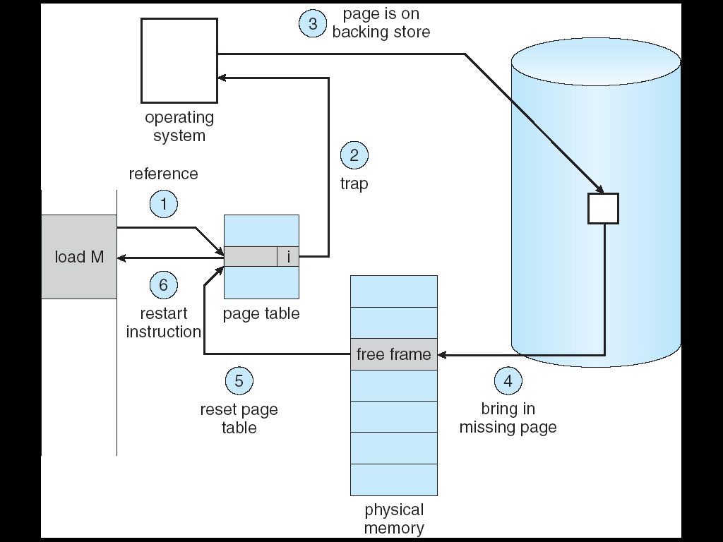
Virtual Memory Accessing: Illustration

Slide 9
Virtual Memory: Justification
Secondary Storage access time
>> Physical memory access time
If memory access results in page fault most of the time == Thrashing
How do we know that thrashing is unlikely to happen?
Related: How do we know that after a page is loaded, it is likely to be useful for future accesses?

Slide 10
Recap: Locality Principles
Most programs exhibit these behaviors:
Most time are spent on a relatively small part of code only
In a time period, accesses are made to a relatively small part of data only
Locality principles:
Temporal Locality:
Memory address which is used is likely to be used again
Spatial Locality:
Memory addresses close to a used address is likely to be used

Slide 12
Virtual Memory and Locality Principle
Exploiting Temporal Locality:
After a page is loaded to physical memory, it is likely to be accessed in near future
Exploiting Spatial Locality:
A page contains contiguous locations that is likely to be accessed in near future

Slide 13
Virtual Memory: Summary
Summary

Slide 14
common application
Hmm…. let's use VM to handle this problem…

Slide 15
Motivation
When a new process is launched, should ALL text (instruction), data (global variables etc) pages be allocated in RAM?
Considerations:
Large startup cost if there are large number of pages to allocate and initialize
But, how do we know which pages to load if we don’t load all?
Need to reduce the footprint of process in physical memory so that more processes can be memory resident

Slide 16
Demand Paging
Simple idea:
Process start with no memory resident page
Only allocate a page when there is a page fault
Pros:
Fast startup time for new process
Small memory footprint
Cons:
Process may appear sluggish at the start due to multiple page faults
The page faults may have cascading effect on other processes (i.e. thrashing)

Slide 17
Page Table Structure
Waste not, want not

Slide 18
More on Virtual Memory Management
Huge page table with large logical memory space
➔ How to structure the page table for efficiency?
Page Table Structures
Each process has limited number of resident memory pages
➔ Which page should be replaced when needed?
Page Replacement Algorithms
Limited physical memory frames
➔ How to distribute among the processes?
Frame Allocation Policies

Slide 19
Page Table Structure
Page table information is kept with the process information and takes up physical memory space
Modern computer systems provide huge logical memory space
4GiB(32bit) is the norm, 8TiB or more is possible now
Huge logical memory space ➔ Huge number of pages
Each page has a page table entry ➔ Huge page table
Problems with huge page table
High overhead
Fragmented page table:
Page table occupies several memory pages

Slide 20
Page Table Structure: Direct Paging
Direct Paging: keep all entries in a single table
With 2^{p} pages in logical memory space
p bits to specify one unique page
2^{p} page table entries (PTE) with:
physical frame number + additional information bits
Example:
Virtual Address: 32 bits, Page Size = 4KiB
P = 32 – 12 = 20
Size of PTE = 2 bytes
Page Table Size = 2²⁰ * 2 bytes = 2MiB (!)
Notes:
Change PTE size to 4 bytes for more realistic example

Slide 21
2-Level Paging: Basic Idea
Observation:
Process may not use entire virtual memory space
➔ Full page table is a waste!
Basic Idea:
Split the full page table into regions
Only a few regions are used
As memory usage grows, new region can be allocated
This idea is similar to split logical memory space into pages ☺
Need a directory to keep track of the regions
Analogues of page table ⬅➔ pages

Slide 22
2-Level Paging: Description
Split page table into smaller page tables
Each with a page table number
If the original page table has 2^{P} entries:
With 2^{M} smaller page tables, M bits is needed to uniquely identify one page table
Each smaller page table contains 2^{(P-M)} entries
To keep track of the smaller page tables
A single page directory is needed
Page directory contains 2^{M} indices to locate each of the smaller page table

Slide 24
2-level Paging
virtual address
page #
page dir #
page #
offset
page table
page directory
frame #
offset
Page Directory
Base Register
physical address
.
.
.
.
.
.
Notes:
Redraw and merge with previous example

Slide 25
2-Level Paging: Advantages
We can have empty entries in the page directory
The corresponding page tables need not be allocated!
Using the same setting as the previous example:
Assume only 3 page tables is in used
Overhead = 1 page directory + 3 smaller page tables
Virtual Address: 32bit
Page Size: 4KiB (2¹²)
PTE Size = 2 bytes
2¹¹ entries
Page Tables
Overhead
= 3 x (2¹¹ x 2) = 12KiB
2¹¹ entries
Page Directory 2²⁰ / 2¹¹ = 2⁹ entries
Overhead
= 2⁹ x 2 = 1KiB
2¹¹ entries
Empty
Empty
Total Overhead
= 1KB + 12KB =13KiB

Slide 26
Inverted Page Table: Basic Idea
Page table is a per-process information
With M processes in memory, there are M independent page tables
Observation:
Only N physical memory frames can be occupied
Out of the M page tables, only N entries is valid
Huge waste: N << Overhead of M page tables
Idea:
Keep a single mapping of physical frame to <pid, page#>
pid = process id , page# = page number
page# is not unique among processes
pid + page# can uniquely identify a memory page
Notes:
Emphasize this is a hardware solution?

Slide 27
Inverted Page Table: Basic Idea (cont)
In normal page table, the entries are ordered by page number
To lookup page X, simply access the Xth entry
In inverted page table, the entries are ordered by frame number
To lookup page X, need to search the whole table
Advantage:
Huge saving: One table for all processes
Disadvantage:
Slow translation

Slide 28
Inverted Table: Illustration
Physical Memory
Frame 0
CPU
i
D
Frame 1
PID
P
D
Frame 2
Frame 3
Frame 4
Frame 5
i
PID
P
Frame 6
Frame 7
Inverted Page Table
Notes:
P change to Pg

Slide 29
Page Replacement Algorithms
Who should I kick out next?

Slide 30
Page Replacement Algorithms
No free physical memory frame during a page fault:
➔ Need to evict (free) a memory page
When a page is evicted:
Clean page: not modified ➔ no need to write back
Dirty page: modified ➔ need to write back
Algorithms to find a suitable replacement page
Optimum (OPT)
FIFO
Least Recently Used
Second-Chance (Clock)
etc…

Slide 31
Modeling Memory References
In actual memory reference:
Logical Address = Page Number + Offset
However, to study the page replacement algorithm
Only page number is important
➔ To simplify discussion, memory references are often modeled as memory reference strings, i.e. a sequence of page numbers

Slide 32
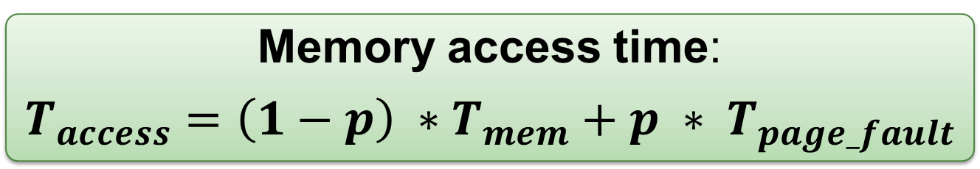
Page Replacement Algorithms: Evaluation
Memory access time:
$$T_{access}=\left(1−p\right) ∗T_{mem}+p ∗ T_{page_fault}$$
𝒑 = probability of page fault
T_{mem} = access time for memory resident page
T_{page_fault} = access time if page fault occurs
Since T_{page_fault} >> T_{mem}
Need to reduce p to keep T_{access} reasonable
See for yourself, try to find 𝒑 if:
T_{mem} = 100ns, T_{page_fault} = 10ms, T_{access} = 120ns
Good algorithm should reduce the total number of page faults

Slide 33
Optimal Page Replacement (OPT)
General Idea:
Replace the page that will not be used again for the longest period of time
Guarantees minimum number of page faults
Unfortunately, not realizable:
Need future knowledge of memory references
Still useful:
As a base of comparison for other algorithms
The closer to OPT == better algorithm

Slide 34
OPT (6 Page Faults)
Time | Memory Reference | Frame |  |  | Next Use Time |  |  | Fault?
 |  | A | B | C
1 | 2 | 2 |  |  | 3 | ◎ | ◎ | Y
2 | 3 | 2 | 3 |  | 3 | 9 | ◎ | Y
3 | 2 | 2 | 3 |  | 6 | 9 | ◎
4 | 1 | 2 | 3 | 1 | 6 | 9 | ◎ | Y
5 | 5 | 2 | 3 | 5 | 6 | 9 | 8 | Y
6 | 2 | 2 | 3 | 5 | 10 | 9 | 8
7 | 4 | 4 | 3 | 5 | ◎ | 9 | 8 | Y
8 | 5 | 4 | 3 | 5 | ◎ | 9 | 11
9 | 3 | 4 | 3 | 5 | ◎ | ◎ | 11
10 | 2 | 2 | 3 | 5 | 12 | ◎ | 11 | Y
11 | 5 | 2 | 3 | 5 | ◎ | ◎ | 11
12 | 2 | 2 | 3 | 5 | ◎ | ◎ | ◎

Slide 35
FIFO Page Replacement Algorithm
General Idea:
Memory pages are evicted based on their loading time
Evict the oldest memory page
Implementation:
OS maintain a queue of resident page numbers
Remove the first page in queue if replacement is needed
Update the queue during page fault trap
Simple to implement
No hardware support needed

Slide 36
FIFO (9 Page Faults)
Time | Memory Reference | Frame |  |  | Loaded at Time |  |  | Fault?
 |  | A | B | C
1 | 2 | 2 |  |  | 1 |  |  | Y
2 | 3 | 2 | 3 |  | 1 | 2 |  | Y
3 | 2 | 2 | 3 |  | 1 | 2
4 | 1 | 2 | 3 | 1 | 1 | 2 | 4 | Y
5 | 5 | 5 | 3 | 1 | 5 | 2 | 4 | Y
6 | 2 | 5 | 2 | 1 | 5 | 6 | 4 | Y
7 | 4 | 5 | 2 | 4 | 5 | 6 | 7 | Y
8 | 5 | 5 | 2 | 4 | 5 | 6 | 7
9 | 3 | 3 | 2 | 4 | 9 | 6 | 7 | Y
10 | 2 | 3 | 2 | 4 | 9 | 6 | 7
11 | 5 | 3 | 5 | 4 | 9 | 11 | 7 | Y
12 | 2 | 3 | 5 | 2 | 9 | 11 | 12 | Y

Slide 37
FIFO: Problems
If physical frame increases
The number page fault should decrease
FIFO violates this simple intuition!
Use 3 / 4 frames to try: 1 2 3 4 1 2 5 1 2 3 4 5
Opposite behavior (↑ frames ➔ ↑ page faults)
Known as Belady's Anomaly
Reason:
FIFO does not exploit temporal locality

Slide 38
Least Recently Used (LRU)
General Idea:
Make use of temporal locality:
Replace the page that has not been used in the longest time
Expect a page to be reused in a short time window
Have not used for some time ➔ most likely will not be used again
Notes:
Attempts to approximate the OPT algorithm
Gives good results generally
Does not suffer from Belady's Anomaly

Slide 39
LRU (7 Page Faults)
Time | Memory Reference | Frame |  |  | Last Use Time |  |  | Fault?
 |  | A | B | C
1 | 2 | 2 |  |  | 1 |  |  | Y
2 | 3 | 2 | 3 |  | 1 | 2 |  | Y
3 | 2 | 2 | 3 |  | 3 | 2
4 | 1 | 2 | 3 | 1 | 3 | 2 | 4 | Y
5 | 5 | 2 | 5 | 1 | 3 | 5 | 4 | Y
6 | 2 | 2 | 5 | 1 | 6 | 5 | 4
7 | 4 | 2 | 5 | 4 | 6 | 5 | 7 | Y
8 | 5 | 2 | 5 | 4 | 6 | 8 | 7
9 | 3 | 3 | 5 | 4 | 9 | 8 | 7 | Y
10 | 2 | 3 | 5 | 2 | 9 | 8 | 10 | Y
11 | 5 | 3 | 5 | 2 | 9 | 11 | 10
12 | 2 | 3 | 5 | 2 | 9 | 11 | 12

Slide 40
LRU: Implementation Details
Implementing LRU is not easy:
Need to keep track of the "last access time" somehow
Need substantial hardware support
Approach A - Use a Counter:
A logical "time" counters, which is incremented for every memory reference
Page table entry has a "time-of-use" field
Store the time counter value whenever reference occurs
Replace the page with smallest "time-of-use"
Problems:
Need to search through all pages
"Time-of-use" is forever increasing (overflow possible!)

Slide 41
LRU: Implementation Details (cont)
Approach B - Use a "Stack":
Maintain a stack of page numbers
If page X is referenced
Remove from the stack (for existing entry)
Push on top of stack
Replace the page at the bottom of stack
No need to search through all entries
Problems:
Not a pure stack: Entries can be removed from any where in the stack
Hard to implement in hardware

Slide 42
Second-Chance Page Replacement (CLOCK)
General Idea:
Modified FIFO to give a second chance to pages that are accessed
Each PTE now maintains a "reference bit":
1 = Accessed, 0 = Not accessed
Algorithm:
The oldest FIFO page is selected
If reference bit == 0 ➔ Page is replaced
If reference bit == 1 ➔ Page is given a 2nd chance
Reference bit cleared to 0
Arrival time reset ➔ page taken as newly loaded
Next FIFO page is selected, go to Step 2
Degenerate into FIFO algorithm
When all pages has reference bit == 1

Slide 43
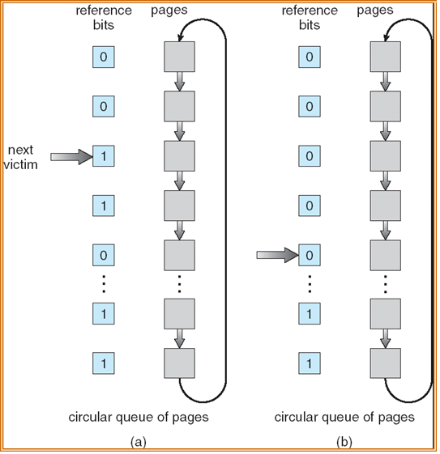

Second-Chance: Implementation Details

Slide 44
CLOCK( 6 Page Faults )
Time | Memory Reference | Frame (with Ref Bit) |  |  | Fault?
 |  | A | B | C
1 | 2 | ►2 (0) |  |  | Y
2 | 3 | ►2 (0) | 3 (0) |  | Y
3 | 2 | ►2 (1) | 3 (0)
4 | 1 | ►2 (1) | 3 (0) | 1 (0) | Y
5 | 5 | 2 (0) | 5 (0) | ►1 (0) | Y
6 | 2 | 2 (1) | 5 (0) | ►1 (0)
7 | 4 | ►2 (1) | 5 (0) | 4 (0) | Y
8 | 5 | ►2 (1) | 5 (1) | 4 (0)
9 | 3 | 2 (0) | 5 (0) | ►3 (0) | Y
10 | 2 | 2 (1) | 5 (0) | ►3 (0)
11 | 5 | 2 (1) | 5 (1) | ►3 (0)
12 | 2 | 2 (1) | 5 (1) | ►3 (0)
Notes:
Use circular queue to maintain the pages:
With a pointer pointing to the oldest page ( the victim page )
To find a page to be replaced:
Advance until a page with '0' reference bit
Clear the reference bit as pointer passes through

Slide 45
Frame Allocation
Which process should I favor?

Slide 46
Frame Allocation
Consider:
There are N physical memory frames
There are M processes competing for frames
Best way to distribute the N frames?
Simple Approaches:
Equal Allocation:
Each process get N / M frames
Proportional Allocation:
Processes are different in size (memory usage)
Let size_{p} = size of process p, size_{total} = total size of all processes
Each process get size_{p}/size_{total}*N frames

Slide 47
Frame Allocation and Page Replacement
The implicit assumption for page replacement algorithms:
Victim page are selected among pages of the process that causes page fault
Known as local replacement
If victim page can be chosen among all physical frames:
Process P can take a frame from Process Q by evicting Q's frame during replacement!
Known as global replacement

Slide 48
Local vs Global Replacement
Local Replacement:
Pros:
Frames allocated to a process remain constant ➔ Performance is stable between multiple runs
Cons:
If frame allocated is not enough ➔ hinder the progress of a process
Global Replacement:
Pros:
Allow self-adjustment between processes
Process that needs more frame can get from other
Cons:
Badly behave process can affect others
Frames allocated to a process can be different from run to run

Slide 49
Frame Allocation and Thrashing
Insufficient physical frame ➔ Thrashing
Heavy I/O to bring non-resident pages into RAM
Hard to find the right number of frames:
If global replacement is used:
A thrashing process "steals" page from other process
cause other process to thrash (Cascading Thrashing)
If local replacement is used:
Thrashing can be limited to one process
But that single process can hog the I/O and degrades the performance of other processes

Slide 50
Finding the right number of frames…
Observation:
The set of pages referenced by a process is relatively constant in a period of time
Known as locality
However, as time passes, the set of pages can change
Notes:
Example:
When a function is executing, the references are likely on:
local variables, parameters, code in that function
these pages define the locality for the function
After the function terminates, the references will changes to another set of pages

Slide 51
Working Set Model
Using the observation on locality:
In a new locality:
A process will cause page fault for the set of pages
With the set of pages in frame:
No/few page fault until process transits to new locality
Working Set Model:
Defines Working Set Window Δ
An interval of time
W(t,Δ) = active pages in the interval at time t
Allocate enough frames for pages in W(t, Δ) to reduce possibility of page fault

Slide 52
Working Set Model: Illustration
Working Set Size
Pages
Transient region:
working set changing
in size
Stable region:
working set about the
same for a long time
Time
Accuracy of working set model is directly affected by the choice of Δ
Too small: May miss pages in the current locality
Too big: May contains pages from different locality

Slide 53
Working Set Model: Illustration
Example memory reference strings
… | 2 | 6 | 5 | 7 | 1 | 1 | 2 | 7 | 5 | 6 | 3 | 4 | 4 | 4 | 3 | 5 | 3 | …
Δ
Δ
t1
t2
Assume
Δ = an interval of 5 memory references
W(t1,Δ)={1,2,5,6,7} (5 frames needed)
W(t2,Δ)={3,4} (2 frames needed)
Try using different Δ values

Slide 54
Summary
Covered virtual memory
How it works and why is it needed
Discussed different aspects of virtual memory management
Use different page table structure to reduce page table overhead
Use different page replacement algorithms to reduce page fault
How frame allocation affects page fault of a process

Slide 55
The Memory Hierarchy
register
increasing size
+decreasing cost
faster access
cache
main memory
secondary storage
Storage Type | Access Time | Size
Registers | 0.25-0.5ns | ~ 128
Cache | 0.5-25ns | ~ 6Mb
Main Memory | 80-250ns | ~ 16Gb
Disk | ~5000000ns | ~ 500Gb
E

Slide 56
Page Fault: Illustration
frame 0
Page 3
swap 0
Page 4
Page 0
1
Page 5
1
Page 1
0
0
F4
T
2
2
Need Page 2
1
Page 2
1
S4
F
2
CPU
2
F5
T
3
3
Page 3
Page 3
3
3
S3
F
F0
T
Need Page 3
4
4
Page 0
4
Page 1
4
S0
F
CPU
Page 4
5
5
F1
T
5
Page 2
5
Page 5
page table
……
……
Virtual Memory Space
physical memory
Secondary Storage
E

Slide 57
A King and his small castle
Throne Rm
I have a small castle
Ballroom
Bed Rm 1
... ...
Bed Rm 101
Washroom 1
... ...
Washroom 63
E

Slide 58
A King and his er…. big HDB
Throne Rm
I have to go to Throne Room NOW
Bed Room 84, Here I come!
Ballroom
Throne Rm
Bed Rm 1
Bed Rm 84
... ...
Washroom 33
Bed Rm 101
Washroom 1
... ...
Washroom 63
E

Slide 59
Virtual Memory: Summary
Summary
Completely separate logical memory address from physical memory
Amount of physical memory no longer restrict the size of logical memory address
More efficient use of physical memory
Page currently not needed can be on secondary storage
Allow more processes to reside in memory
Improve CPU utilization as there are more processes to choose from
E

Slide 60
Demand Paging 1
P has 5 pages
frame 0
Page 3
swap 0
1
Page 1
1
0
0
F4
T
2
Page 4
2
1
1
F1
T
2
2
F5
T
3
3
3
3
F0
T
4
4
Page 0
4
4
F2
T
5
5
--
--
5
Page 2
5
page table
……
……
physical memory
Secondary Storage
E

Slide 61
Demand Paging 2
P has 5 pages
frame 0
Page 3
swap 0
Page 0
1
1
Page 1
0
0
S0
F
F4
T
2
2
Page 2
1
1
S1
F
2
Need Page 3
2
S2
F
3
3
Page 3
Need Page 0
3
3
S3
F
F0
T
CPU
CPU
4
Page 0
Page 4
4
4
4
S4
F
5
5
--
--
5
page table
5
……
……
physical memory
Secondary Storage
E

Slide 62
INVERTED TAble
E

Slide 63

Virtual Memory Accessing
0
Page 4
0
0
4
T
1
1
1
4
F
2
2
2
5
T
3
3
3
F
3
Page 3
4
4
0
F
4
Page 1
5
5
1
T
6
-
5
6
-
F
0
6
page table
page table
1
Page 5
Secondary Storage
(Hard Disk)
2
3
4
Page 0
5
Page 2
6
Physical Memory
(RAM)

Slide 64
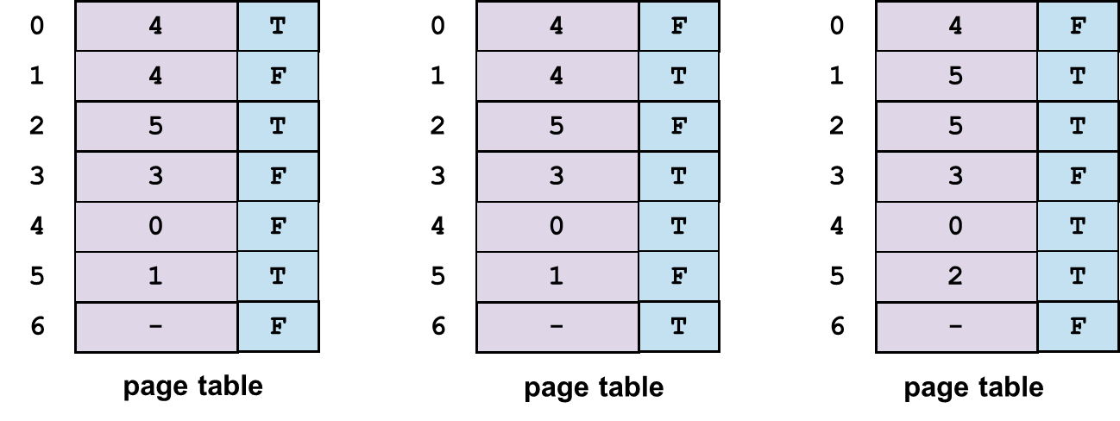
Virtual Memory Accessing
0
4
T
0
4
F
0
4
F
1
4
F
1
4
T
1
5
T
2
5
T
2
5
F
2
5
T
3
3
F
3
3
T
3
3
F
4
0
F
4
0
T
4
0
T
5
1
T
5
1
F
5
2
T
6
-
F
6
-
T
6
-
F
page table
page table
page table

Slide 65
Virtual Memory Accessing: Illustration
0
Page 4
1
0
4
0
T
1
4
2
1
F
2
5
3
Page 3
2
T
3
3
F
4
3
Page 1
4
0
F
4
5
5
1
5
T
0
6
6
-
6
-
F
1
Page 5
Secondary Storage
(Hard Disk)
page table
page table
2
3
4
Page 0
5
Page 2
6
Physical Memory
(RAM)

Slide 66
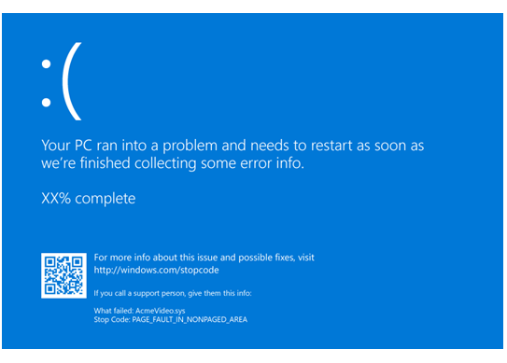
Windows 10 – Page Fault

